Slide 1
Web-Based Cryptographic Concealment through QR-Activated Image Steganography
Vijayadharshni
21BCE1072

Slide 2
Introduction
In our interconnected world, cryptography is pivotal for securing sensitive information.
Our project employs QR codes to reveal a webpage, concealing encrypted messages within seemingly ordinary images, resembling advertisements.
By converting a string into a image and encrypting the embedded message, we're bolstering security in an unconventional yet effective manner.
In response to evolving cyber threats, our initiative provides a practical method for securing information, maintaining a facade of normalcy.

Slide 3
Literature survey
Year | Title | Author | Objective
2021 | Image Steganography: A Review of the Recent Advances | Nandhini Subramanian, Omar Elharrouss, Somaya Al-Maadeed. | This paper aims to examine and categorize deep learning methods in image steganography, specifically traditional, Convolutional Neural Network-based, and General Adversarial Network-based approaches.

Slide 4
2021 | Double layer security using crypto-stego techniques: a comprehensive review | Aiman Jan,Shabir A. Parah, Muzamil Hussan, Bilal A. Malik | This work reviews recent advancements in information security, specifically exploring the fusion of cryptography and steganography for double-layer security in covert communication, emphasizing image steganography techniques and evaluating their effectiveness.
2019 | A Study of Data Hiding Using Cryptography and Steganography | Priya Mathur Poornima, Amit Kumar Gupta | This paper addresses the challenges in securing confidential data transmitted over networks, exploring the combined use of cryptography and steganography.

Slide 5
2019 | A Study of Data Hiding Using Cryptography and Steganography | Priya Mathur Poornima, Amit Kumar Gupta | This paper addresses the challenges in securing confidential data transmitted over networks, exploring the combined use of cryptography and steganography.
2016 | Advances in digital image steganography | Rupali Jain, Jayshree Boaddh | The paper provides a comprehensive overview of recent advancements in digital image steganography and steganalysis.

Slide 6
2019 | A Comparative Study of Recent Steganography Techniques for Multiple Image Formats | Arshiya Sajid Ansari, M ohammad Sajid Moham madi, Mohammad Tanvi r Parvez | The paper compares and analyzes recent steganography techniques for multiple image formats, including BMP, GIF, JPEG, and PNG. The aim of the study is to evaluate the strengths and weaknesses of each technique and identify the best-performing techniques for each image format.
2016 | Enhancing security of images by Steganography and Cryptography techniques | Sadaf Bukhari, Muhammad Shoaib Arif, M.R. Anjum, and Samia Dilbar | Enhancing security of images by Steganography and Cryptography techniques". These studies have explored various steganography and cryptography techniques and their performance in terms of security and robustness.

Slide 7
2016 | A Proposed Novel Architecture for Information Hiding in Image Steganography by using Genetic Algorithm and Cryptography | Pratiksha Sethia , V. Kapoorb | This system aims to enhance data security for internet applications by combining compression, AES encryption, and steganography. It conceals encrypted data in images, utilizing Genetic Algorithm for pixel assortment to fortify defense against data threats and secure network communication.
2010 | Visual cryptographic steganography in images | Piyush Marwaha, Paresh Marwaha | This paper proposes an advanced system merging cryptography, steganography, and multimedia data hiding to enhance data security against intruder threats.

Slide 8
Research Gaps
Limited studies explore the human aspect of deception in the context of QR codes and encrypted messages within web pages, focusing on users' ability to discern the hidden information.
There is a gap in understanding the effectiveness of concealing encrypted messages within images resembling advertisements, specifically in terms of visual inspection and common detection methods.
Existing literature may lack exploration into dynamic encryption techniques that adapt to different content within the web pages, optimizing the concealment of sensitive information.
Limited research delves into the user experience and interaction aspects when scanning QR codes leading to encrypted web pages, including how seamlessly users navigate and perceive the hidden content.

Slide 9
Objective
The primary objective of this project is to develop a secure and inconspicuous communication system utilizing QR codes, where scanning the code reveals a webpage containing encrypted messages embedded within images resembling advertisements.
The aim is to provide a covert and user-friendly method for secure information exchange, leveraging cryptography and steganography to create a system that appears innocuous to unintended observers while ensuring that only the intended recipient can decipher and access the hidden content.

Slide 10
Base work
Image Steganography:
Image steganography is a technique that conceals information within digital images, allowing for covert communication without attracting attention. Unlike cryptography, which focuses on making the content unintelligible, steganography hides the existence of the message itself.
Text Encryption:
Text encryption involves transforming plain text into an unreadable format, known as ciphertext, using an algorithm and a secret key. The primary objective is to secure sensitive information during communication or storage.

Slide 11
Limitation of Existing Model
Managing encryption keys for secure text communication can be complex, especially when dealing with a large number of users or frequent key changes. The project's use of QR codes for initiating communication simplifies key exchange, making it more user-friendly compared to traditional text encryption.
Steganography techniques may alter the characteristics of the cover image, potentially making the hidden information susceptible to detection through sophisticated analysis.The project's approach of embedding encrypted messages within a webpage may appear as a normal page, minimizing the chances of detection compared to visible alterations in steganographic images.
The capacity for concealing information within images is limited, especially when the cover media has constraints on size or complexity. The project's use of a webpage allows for potentially larger information concealment capacity compared to traditional image steganography.

Slide 12
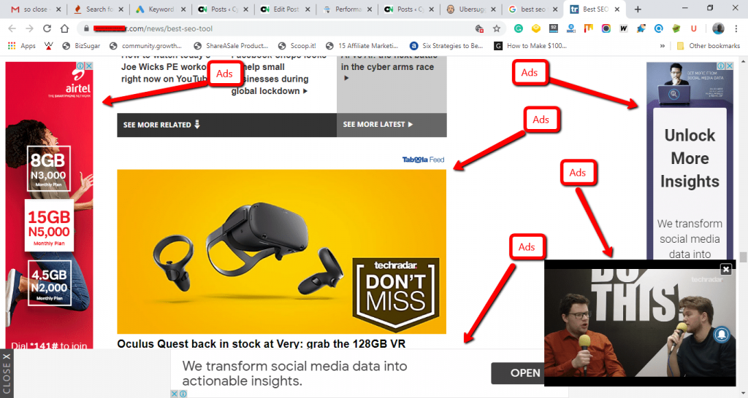
Outline of the Project
To create a secure communication system utilizing QR codes.
Scanning the QR code triggers the project's process.
Upon scanning, a web page is dynamically presented.
Appears as a normal webpage to the viewer.
The content within the webpage is encrypted.
Encryption is applied within images resembling advertisements.
Intention is to make the encrypted content appear inconspicuous.
To enable communication that is discreet and concealed.
Only the intended recipient is aware of the hidden message.
The webpage, disguised as a normal page, enhances user experience.
The use of QR codes simplifies the initiation of secure communication.

Slide 13
Reference
O. Elharrouss, N. Almaadeed and S. Al-Maadeed, "An image steganography approach based on k-least significant bits (k-LSB)", Feb. 2020.
Aiman Jan,Shabir A. Parah, Muzamil Hussan, Bilal A. Malik, “Double layer security using crypto-stego techniques: a comprehensive review”, 2021.
Priya Mathur Poornima, Amit Kumar Gupta, “A Study of Data Hiding Using Cryptography and Steganography”, 2019.
Sadaf Bukhari, Muhammad Shoaib Arif, M.R. Anjum, and Samia Dilbar, “Enhancing security of images by Steganography and Cryptography techniques”, 2016
Rupali Jain, Jayshree Boaddh, “Advances in digital image steganography”, 2016

